Slide 1
The cell biology lab 4
The plasma membrane

Slide 2
Cell Membrane Structure and Function:
All biological membranes are made of two main components:
1- Phosphorus, or phosphate groups (–H₂PO₄R, where R is a functional group) , Functional group: are specific groups of atoms or bonds within molecules that are responsible for the characteristic chemical reactions of those molecules.
2- Lipids : These components combine to create a molecule called a phospholipid.

Slide 3
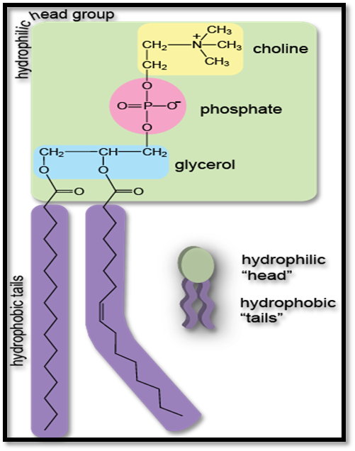

Slide 4
What’s a Phospholipid?
* It’s a pair of fatty acid chains and a phosphate group attached to a glycerol backbone.
* Polar (water-soluble) heads face out and the non polar fatty acids hang inside.

Slide 6
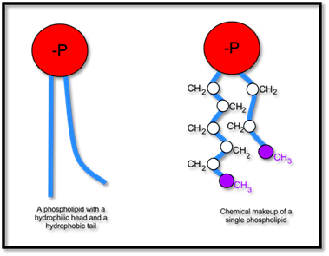

Slide 7
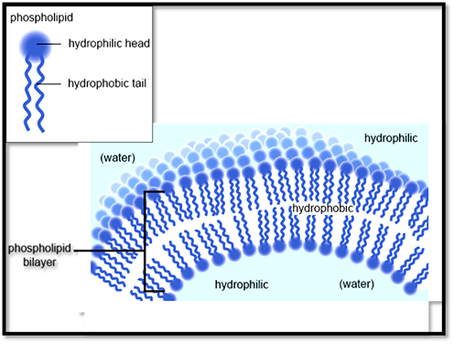

Slide 8
Plasma membrane:
* The cell membrane or plasma membrane is a fluid mosaic of phospholipids and proteins.
* Composed of Two main categories of membrane proteins (integral and peripheral )
1- Peripheral proteins: bound to the surface of the membrane.
2- Integral proteins: permeate the surface of the membrane.

Slide 9
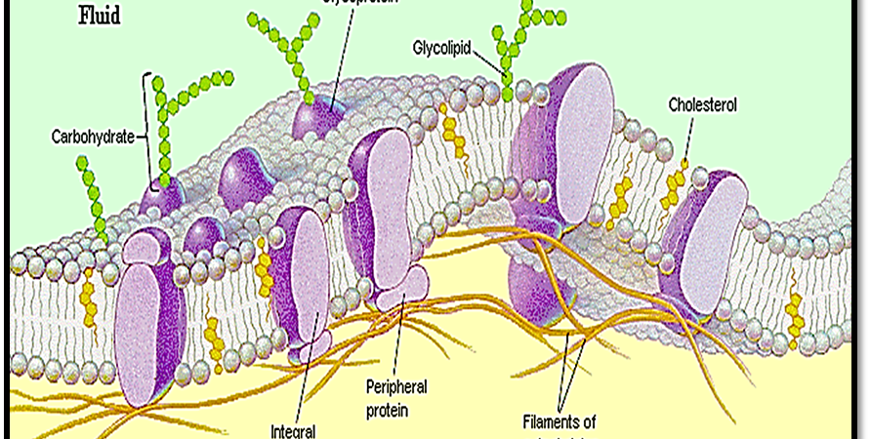
( The Fluid-Mosaic Membrane Model )

Slide 10
Functions:
1- Isolate the cytoplasm from the external environment.
2- Regulate the exchange of substances.
3- Communicate with other cells.

Slide 11
Specializations of cell membrane
One of the main roles of a cell membrane is to absorb nutrients from the surrounding environment In order to do this; the cell membrane must have proteins that detect the presence of molecules that should be taken into the cell. A cell has two ways of maximizing its ability to detect important molecules:

Slide 12
1- Have more protein receptors on its surface membrane that recognize the molecule.
2- Have a larger membrane area in which to place these protein receptors such as microvilli, surface ruffles, cilia and flagella.

Slide 13
Microvilli: are finger-shaped plasma membrane protrusions that are found at the surface of a large variety of cell types for example intestinal mucosa.
Surface ruffles or lamellipodia: is a cytoskeletal protein actin projection on the leading edge of the cell

Slide 14
Cilia & flagella: They are made up of microtubules, motile and designed either to move the cell itself or to move substances over or around the cell.

Slide 15
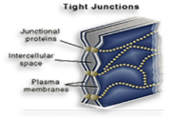
((Membrane junctions ))
Animal cells in multicellular tissues are usually joined by tight junctions, desmosomes, and gap junctions. Plant cells are often joined by plasmodesmata.
1- Tight junction: block the flow of fluids between epithelial cells. For example, the cells that line the intestine are responsible for taking up nutrients from the gut.

Slide 16
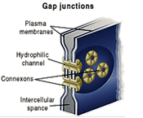
2- Gap junction: are narrow tunnels between cells that consist of proteins called connexons. The proteins allow only the passage of ions and small molecules.

Slide 17
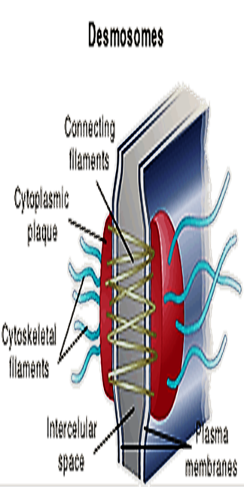
3- Desmosomes: links between cells, and provide a connection between intermediate filaments of the cell cytoskeletons of adjacent cells. This structure gives strength to tissues.

Slide 18
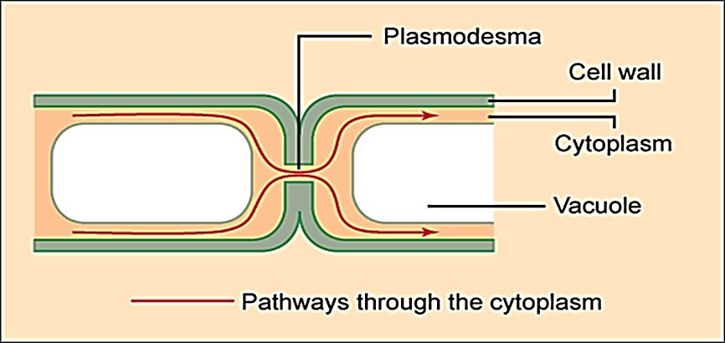
Plasmodesmata: are intercellular junctions between plant cells that enable the transportation of materials between cells.

